Slide 1


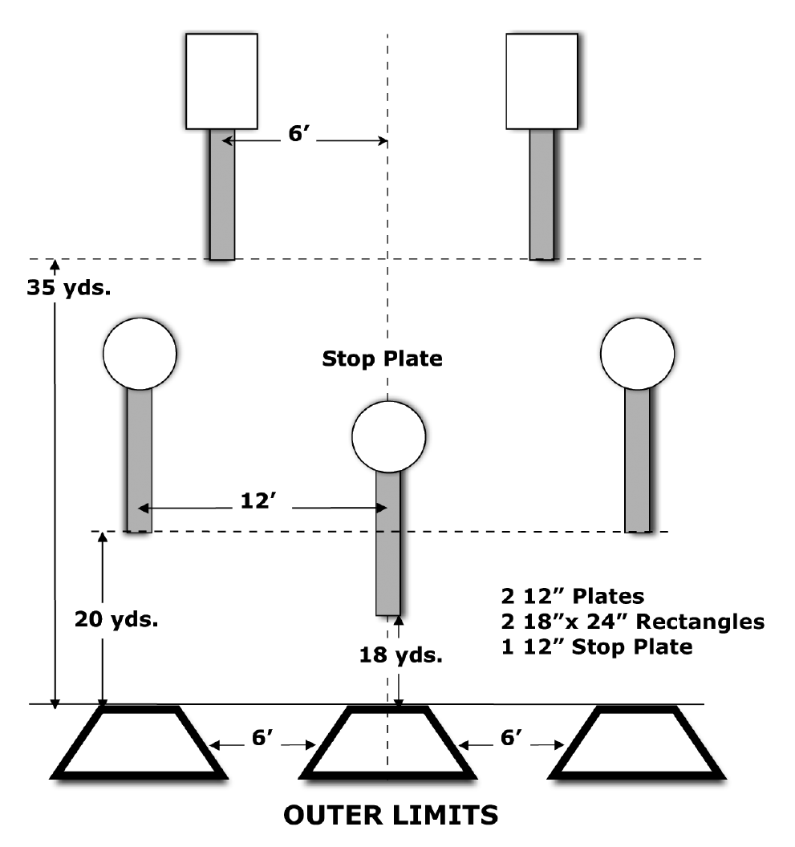
 | Dothan Gun Club – Steel Challenge Match Outer Limits
START POSITION : Starting in weak side shooting box (right handed shooters in left box, left handed in right box)
GUN READY CONDITIONS : Centerfire pistol: gun loaded, holstered, wrists above respective shoulders. Rimfire pistol, rimfire rifle, and PCC: gun loaded and aimed at orange cone/aiming point. |  | SCORING: 4 strings of 5 hits per stage. Worst string in each stage is discarded. TARGETS: 5 Steel SCORED HITS: Hit anywhere on face of steel START-STOP: Audible, hit on stop plate or 30 seconds per string RULES: Each miss per string adds 3 seconds to that string’s time. Hitting the stop plate first in a string makes the time for that string 30 seconds. Hitting a plate from the wrong shooting box will be scored as a miss
STAGE PROCEDURE: Engage the 25 and 35 yard targets on the weak side of the center line, move to the center box and engage the remaining targets plus stop plate.
P1
X
X

